Slide 1

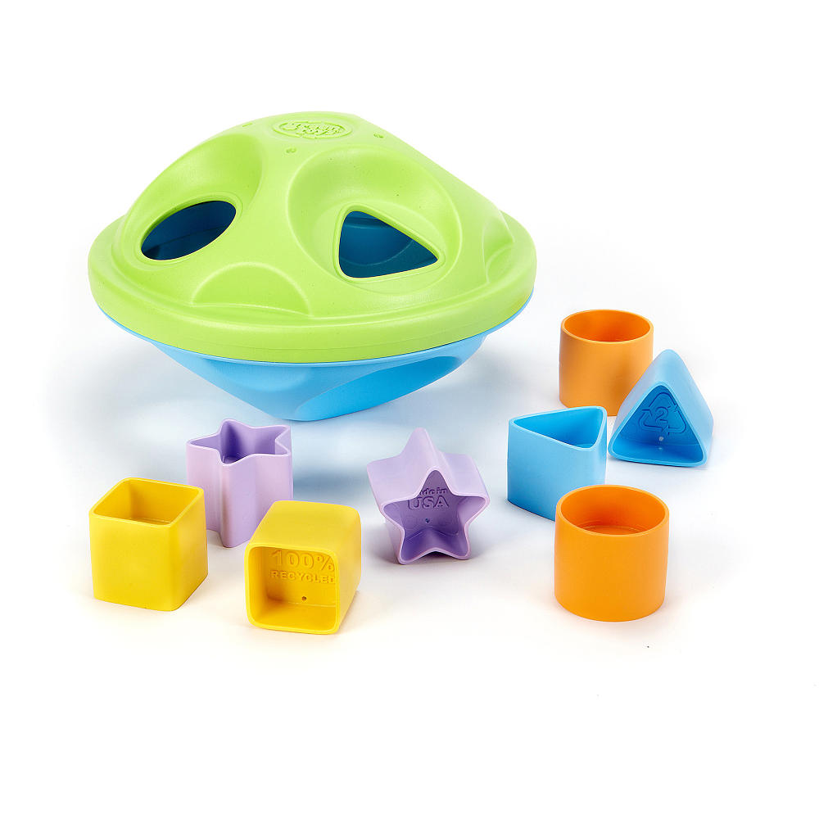
Shape Sorter
Toy Name
Shape Sorter
Manufacturer
Green Toys
Age
15 – 24 months
Parts
8 pieces of shapes
Shape sorter
Develop Skills
Linguistic
Fine motor
Cognitive
How it Works
Bentuk-bentuk yang ringan ini cocok untuk Si Kecil yang baru mulai belajar menggenggam. Anak yang lebih besar dapat melatih kemampuan motorik mereka dan juga belajar mencocokan warna.
-
The lightweight shapes are perfect for little ones just learning to grasp, while older toddlers can practice fine motor skills and color matching.
How To Clean
Simply clean using a cloth that has been sprayed with non-toxic anti bacterial solution
Warning
Do not wash/soak in water
Store in a dry place
Keep out of direct sunlight

